Slide 1
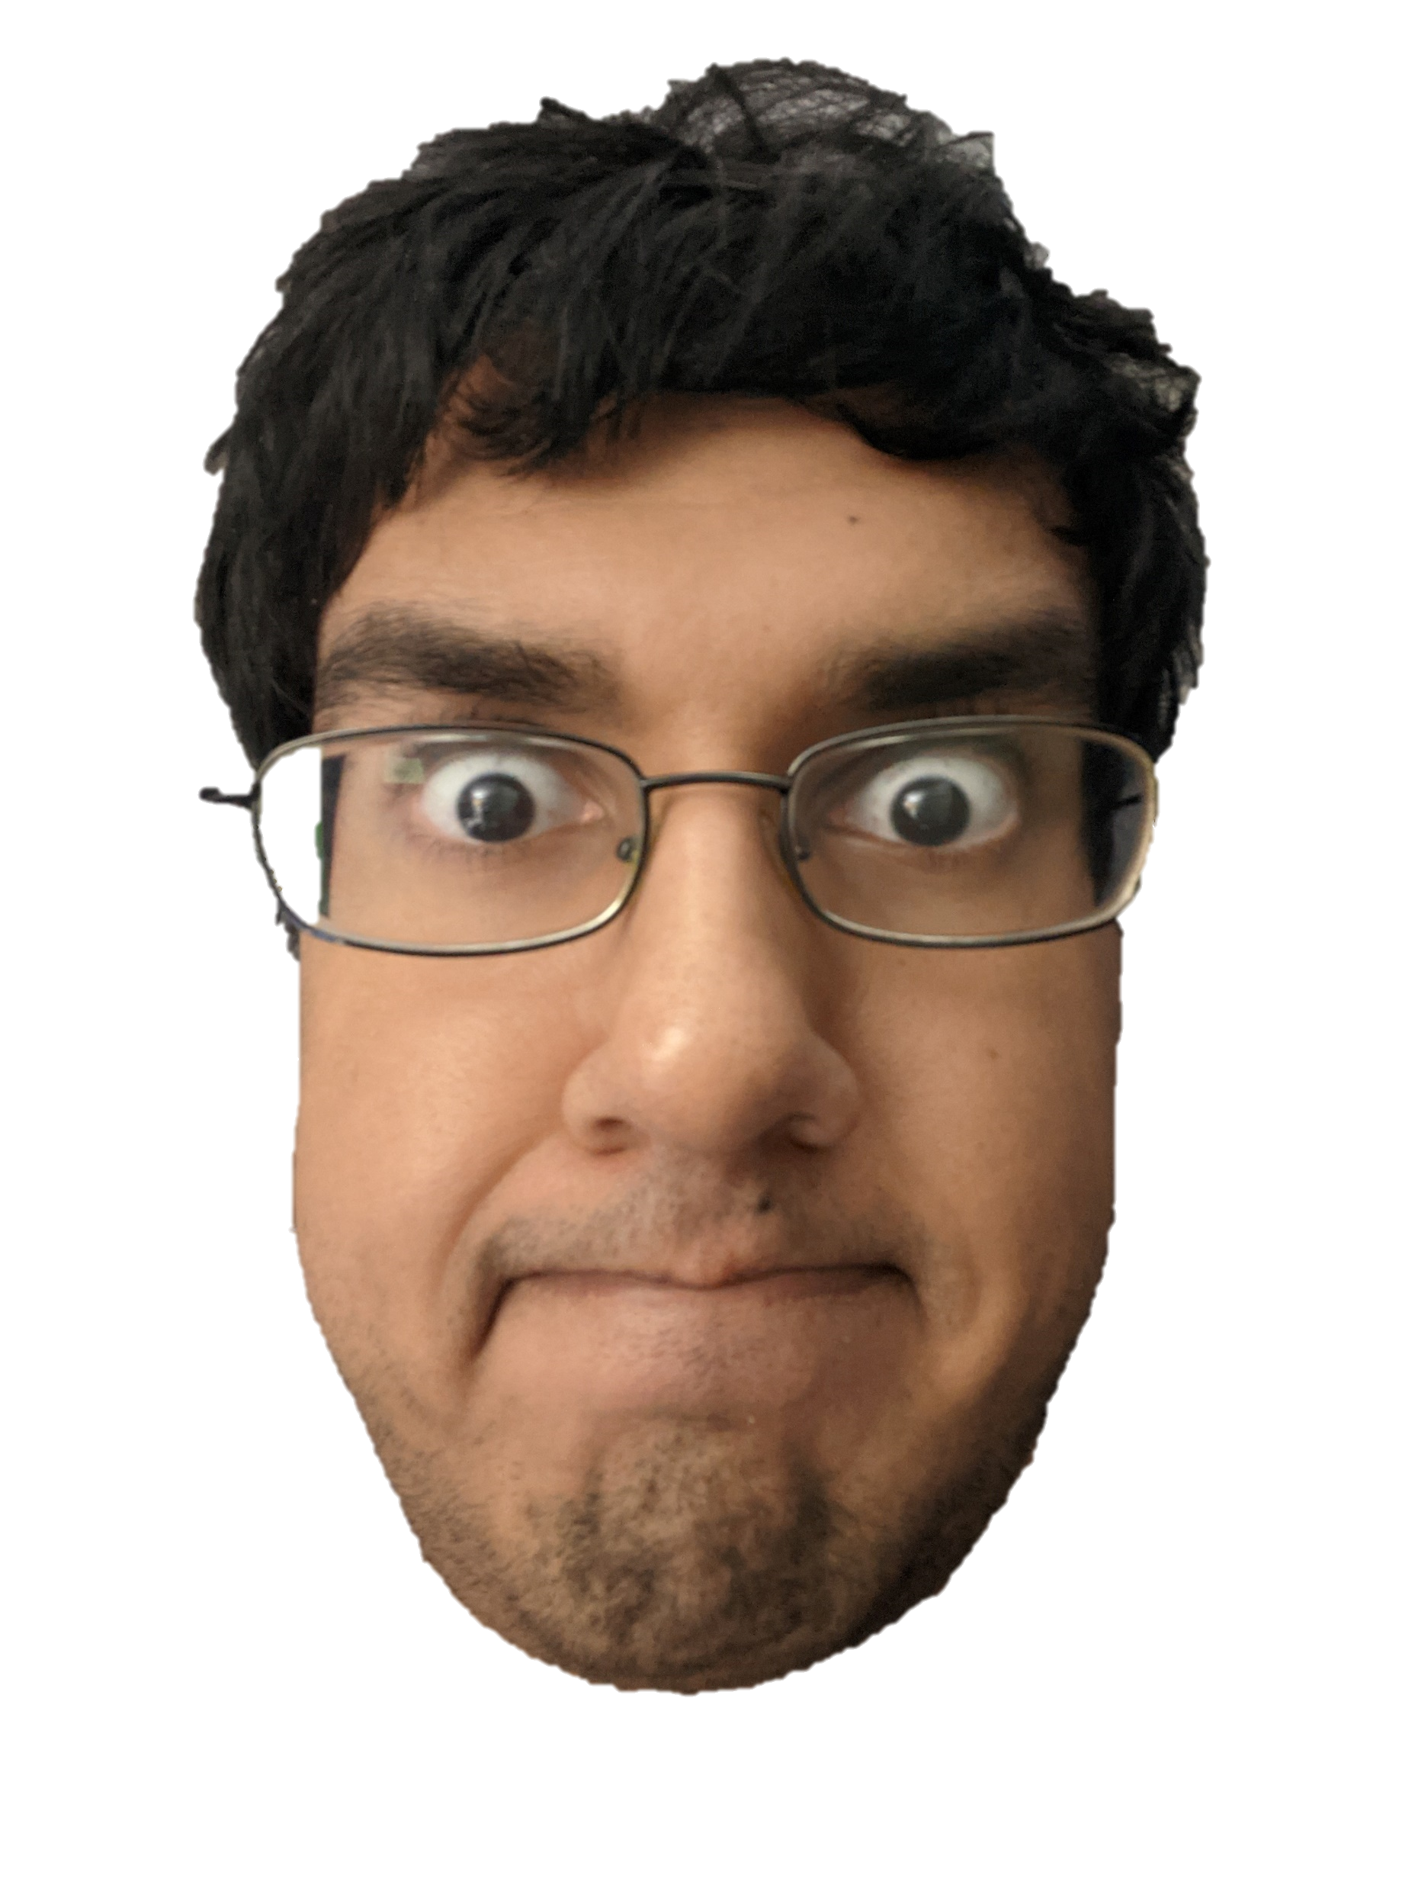
Breakout
Adding Sounds To An Arcade Classic!
https://github.com/ksu-is/Breakout
Level 1
Christopher Persaud

